Slide 1
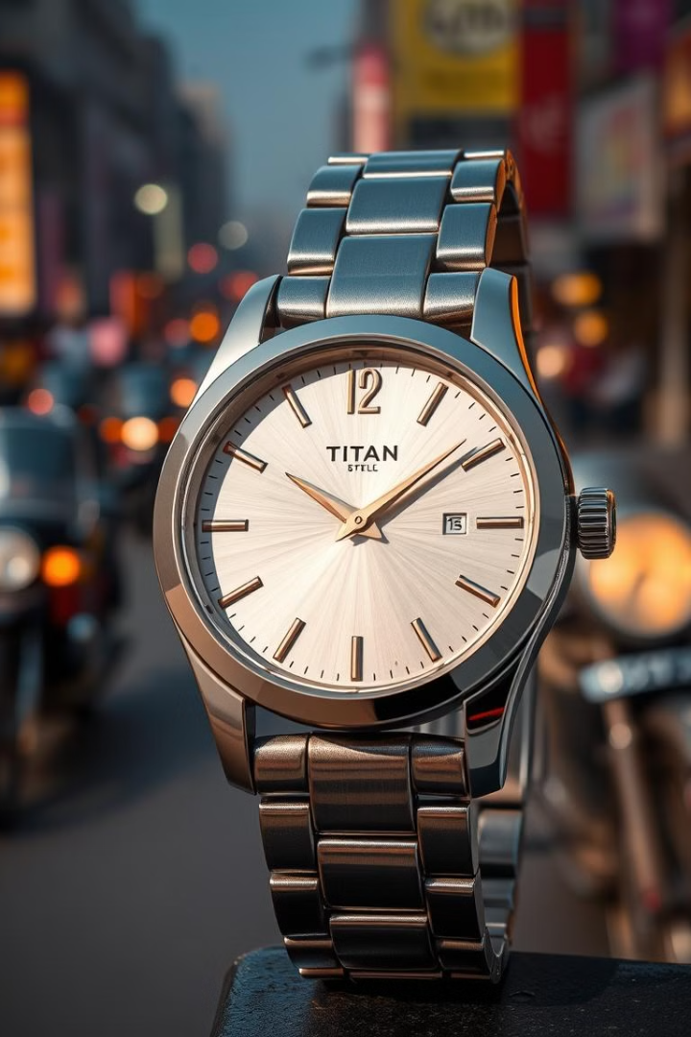
Titan: A Story of Innovation and Market Domination
Titan, India's leading watch brand, has a compelling history, born out of a bold decision to disrupt a market dominated by a government-owned entity. This presentation explores the rise of Titan and its enduring success.
by Pandurang Rayfalwar

Slide 2
The Birth of Titan
HMT's Dominance
Mr.Xerer Desai's Vision
HMT (Hindustan Machine Tools Limited) was a government-owned company established in 1961 by Jawaharlal Nehru in collaboration with Citizen Watch Co. of Japan. At its peak, HMT dominated the Indian watch market, capturing nearly 90% of the market share.
Recognizing a gap in the market, Mr. Xerer Desai, formerly with Taj Hotels Mumbai (TATA Group), envisioned a private player catering to evolving consumer preferences

Slide 3
Entering a Challenging Market
HMT's Monopoly
Titan's Genesis
Despite the high demand, HMT's supply couldn't meet the market's needs, leaving space for a new entrant.
In 1987, Titan was established as a joint venture between the Tata Group and TIDCO, a Tamil Nadu corporation.

Slide 4
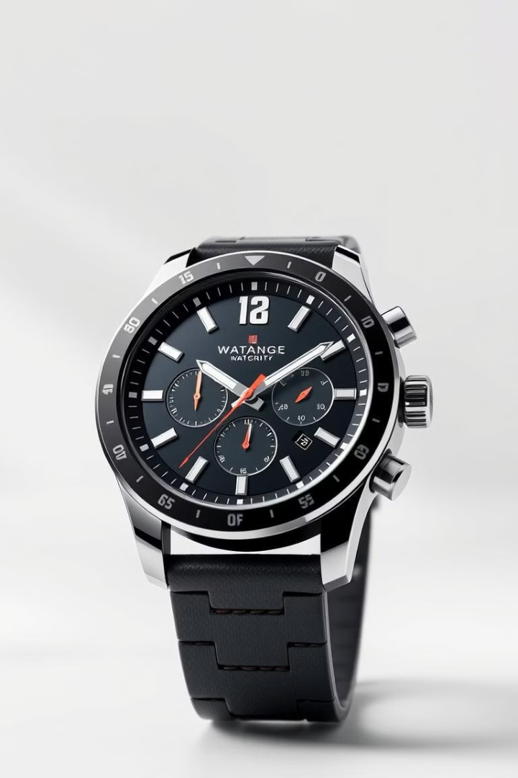
Differentiation and Innovation
1
Quartz Revolution
2
Focus on Youth
Titan introduced quartz watches, a departure from the mechanical watches HMT mainly produced.
Titan targeted a younger demographic with stylish watches, appealing to their desire for fashion statements.

Slide 5
Strategic Positioning and Growth
Location Advantage
Direct Retailing
Titan set up its first factory in Hosur, strategically near HMT, to reduce labor costs and tap into an existing pool of skilled workers.
Titan bypassed distributors, directly selling to retailers, reducing commissions and providing competitive pricing.

Slide 6
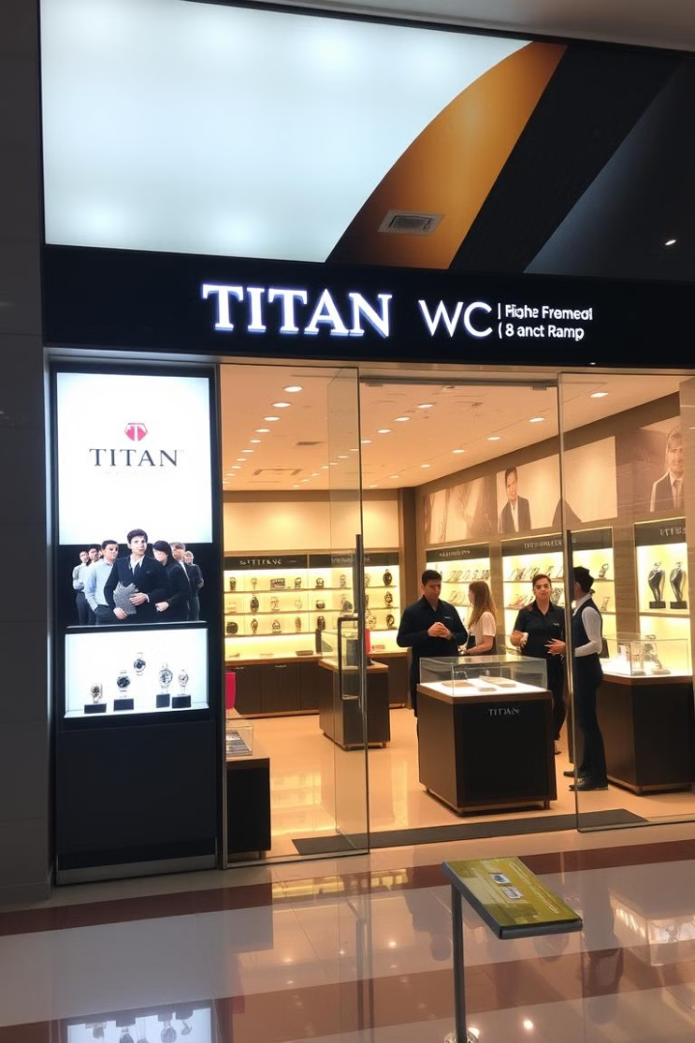
Building a Brand Identity
Elevating Customer Experience
Value-added Services
Titan created modern stores with better parking, lighting, and AC, offering a more welcoming and comfortable shopping experience.
They introduced features like attractive packaging, gift options, and a 30-day return policy, adding value for customers.

Slide 7
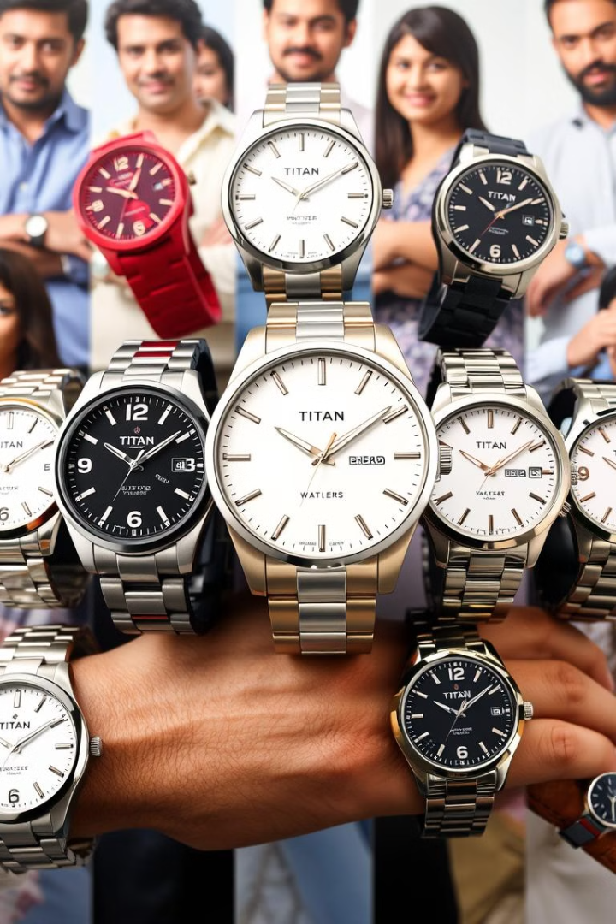



Expanding the Portfolio
Sonata
In 1997, Titan launched Sonata which sold 5 lakh watches within 6 months , a budget-friendly watch brand that resonated with a wider audience.
Raga
Targeting women, Titan introduced Raga, a range of watches designed with elegance and feminine appeal.
Titan Edge
The launch of Titan Edge, a slim and stylish watch, further cemented Titan's innovation and design expertise.

Slide 8



Beyond Watches: A Multi-brand Portfolio
1
Titan
2
Titan Eye+
3
Skinn

Slide 9

Titan's Legacy: A Success Story
Titan has transformed the Indian watch market, becoming a household name. Its innovative approach, commitment to quality, and customer-centric philosophy have made it a global success story.

Slide 10
Thank You…
Pandurang Rayfalwar
pandurangrayfalwar@gmail.com

